Slide 1
EMBARGOED for 5:30pm ET 11/16/19
Balloon-Expandable versus Self-Expanding TAVR:
a Propensity-Matched Comparison from the France-TAVI Registry
Eric Van Belle, MD, PhD on behalf of France TAVI investigators
From CHU Lille, Université de Lille, INSERM; France,
Late-Breaking clinical trial scientific sessions; AHA 2019, Philadelphia,

Slide 2
Disclosures
Eric Van Belle has no disclosure relevant to the content of this study
The FRANCE TAVI database was funded and managed by the French Society of Cardiology
THV manufacturers partly funded the registry but had no role in data collection or analysis or in manuscript drafting
Edwards Lifesciences and Medtronic had no role in data management, data analysis, or writing of the manuscript.
Disclosures of all co-authors are available in the manuscript of the study

Slide 3
Background
Most transcatheter heart valves (THV) available are designed on either a balloon-expandable (BE) or a self-expanding (SE) concept
Despite major differences, both designs are recommended to be used indifferently in most of the clinical situations
To date, no randomized study powered to compare BE­-THV to SE-­THV on individual endpoints has been conducted

Slide 4
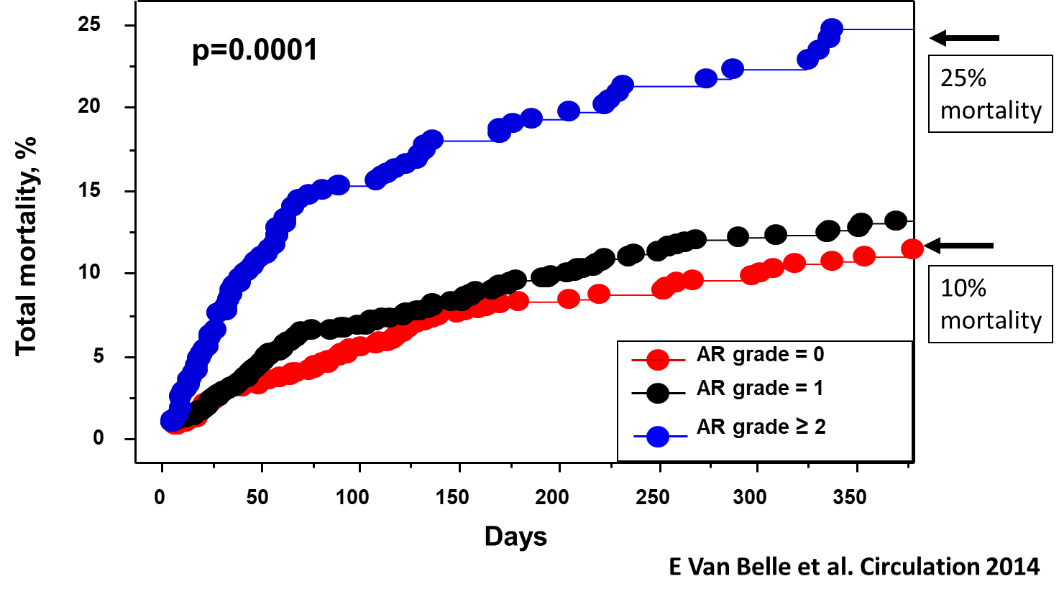
Background
Studies have suggested that Para­Valvular Regurgitation (PVR)≥moderate was ≈ 2-fold more frequent with SE than with BE THV.
PVR ≥ moderate has been associated with a ≈2-fold increased in long ­term mortality after TAVR
In the absence of RCT, propensity-scoring analysis of nationwide registry is the best methodology available to generate hypothesis on possible clinical outcomes differences between THV designs
Van Belle et al, Circulation 2014
Notes:
Supprimer ?

Slide 5
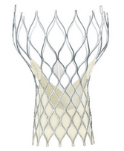
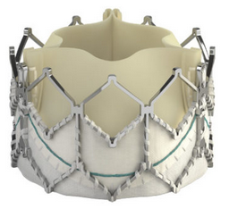
Purpose of the study
To evaluate the impact of THV design (SE vs BE) on the risk of ParaValvular Regurgitation, intra-hospital mortality, and 2-year mortality using a nationwide propensity score matching analysis.
VS

Slide 6
Patient selection
Since Jan 2013, all patients that undergone TAVR in 48/50 TAVR centers in France and gave consent were prospectively included in the FRANCE-TAVI registry (NCT01777828)
For the purposes of the present analysis, a database containing all patients (n=12,804) included until December 31st 2015 was locked.
Exclusion criteria :
Patients referred for a valve-in-valve procedures (n=559)
Patients treated with a different THV-design (n=104)
The decision to perform TAVR, choices of vascular access and THV-design were based on heart-team assessment at each center.
Both commercially available valves were used: the BE-THV SAPIEN-XT (Jan. 2013-last quarter 2014) or BE-THV SAPIEN 3 (last quarter 2014-Dec. 2015) valves (Edwards Lifesciences) and the SE-THV Corevalve family (Medtronic)
12804 patients undergoing TAVR between 01/2013 and 12/2015
559 Valve in Valve TAVR
104 Other valves types
12141 patients included in analysis

Slide 7
Endpoints
1st co primary endpoint = PVR at discharge or all-cause in-hospital mortality
2nd co-primary endpoint = 2-year all-cause mortality
Secondary endpoints :
each individual component of the 1st co-primary endpoint
procedural and in-hospital events (requirement for a second THV, stroke, myocardial infarction, major or life-threatening bleeding, major vascular complication, permanent pacemaker)
post-procedural transprosthetic gradient by echocardiography

Slide 8
Collection of Data and Follow-up
Mortality data were acquired in all patients from an INSEE (Institut national de la statistique et des études économiques) query on April 12th 2016, with dates of death available and with a median follow-up of 20 months (IQR=14-30).
Deaths were classified as cardiovascular unless a clear non-cardiovascular cause was identified.
Post-procedural TTE was performed before hospital discharge with a median of 3 days (IQR=2-4).
AR grading was defined as “mild”, “moderate” or “severe” as previously used in the France 2 registry, according to the European and American Society of Echocardiography guidelines and Valve Academic Research Consortium(VARC)-2 recommendations.
In-hospital complications were assessed according to the VARC-2 classification.
AR grading and in-hospital complications were site reported and not centrally adjudicated.

Slide 9
Statistical analysis and study flow chart
12804 patients treated with SE- or BE THV between 01/2013 and 12/2015
Main analysis: Propensity score matched cohorts:
Prop. Score: 25 clinical, anatomical, and procedural variables
Time of the procedure (within 3 months of each other)
Adjusted on each center
Missing data were handeld by multiple imputations (m=10).
559 Valve in Valve TAVR
104 Other valves types
12141 patients included in analysis
Propensity-score matched cohort
3910 SE-THV
3910 BE-THV
1st co primary outcome = PVR at discharge or all-cause in-hospital mortality
2nd co-primary outcome = 2-year all-cause mortality

Slide 10
Statistical analysis and study flow chart
12804 patients treated with SE- or BE THV between 01/2013 and 12/2015
Main analysis: Propensity score matched cohorts:
Prop. Score: 25 clinical, anatomical, and procedural variables
Time of the procedure (within 3 months of each other)
Adjusted on each center
Missing data were handeld by multiple imputations (m=10).
Sensitivity analysis: IPTW cohort analysis
Propensity score was used to weight each subject by the inverse probability of treatment (stabilized inverse propensity score as weight) and generate an inverse probability treatment weighting (IPTW) cohort.
559 Valve in Valve TAVR
104 Other valves types
IPTW cohort
12141 patients included in analysis
Propensity-score matched cohort
4103 SE-THV
8038 BE-THV
3910 SE-THV
3910 BE-THV
1st co primary outcome = PVR at discharge or all-cause in-hospital mortality
2nd co-primary outcome = 2-year all-cause mortality

Slide 11
RESULTS

Slide 12
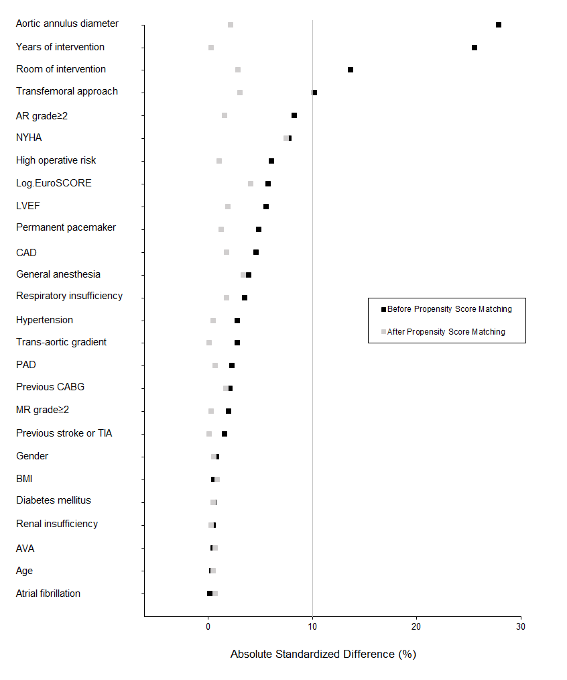
Baseline patients characteristics
 | Before matching
Characteristics | SE-THV (n=4103) | BE-THV (n=8038)
Age | 83.5 ± 7.0 | 83.5 ± 7.1
Men | 2027 (49.4) | 3939 (49.0)
Euroscore | 14.0 (9.0 to 22.5) | 15.0 (9.6 to 23.0)
NYHA 3 | 2257 (55.0) | 4698 (58.4)
CAD | 1830 (44.6) | 3401 (42.3)
PAD | 965 (23.5) | 1814 (22.6)
Renal insufficiency | 210 (5.1) | 421 (5.2)
LVEF | 54.7 ± 13.7 | 55.5 ± 13.7
Aortic annulus diameter | 24.2 ± 2.8 | 23.5 ± 2.7
Transfemoral approach | 3287 (80.1) | 6754 (84.0)
Years of intervention
-01/2013 to 12/2014 | 2619 (63.8) | 4123 (51.3)
-01/2015 to 12/2015 | 1484 (36.2) | 3915 (48.7)

Slide 13
Baseline patients characteristics
 | Before matching
Characteristics | SE-THV (n=4103) | BE-THV (n=8038)
Age | 83.5 ± 7.0 | 83.5 ± 7.1
Men | 2027 (49.4) | 3939 (49.0)
Euroscore | 14.0 (9.0 to 22.5) | 15.0 (9.6 to 23.0)
NYHA 3 | 2257 (55.0) | 4698 (58.4)
CAD | 1830 (44.6) | 3401 (42.3)
PAD | 965 (23.5) | 1814 (22.6)
Renal insufficiency | 210 (5.1) | 421 (5.2)
LVEF | 54.7 ± 13.7 | 55.5 ± 13.7
Aortic annulus diameter | 24.2 ± 2.8 | 23.5 ± 2.7
Transfemoral approach | 3287 (80.1) | 6754 (84.0)
Years of intervention
-01/2013 to 12/2014 | 2619 (63.8) | 4123 (51.3)
-01/2015 to 12/2015 | 1484 (36.2) | 3915 (48.7)

Slide 14
Baseline patients characteristics
 | Before matching
Characteristics | SE-THV (n=4103) | BE-THV (n=8038)
Age | 83.5 ± 7.0 | 83.5 ± 7.1
Men | 2027 (49.4) | 3939 (49.0)
Euroscore | 14.0 (9.0 to 22.5) | 15.0 (9.6 to 23.0)
NYHA 3 | 2257 (55.0) | 4698 (58.4)
CAD | 1830 (44.6) | 3401 (42.3)
PAD | 965 (23.5) | 1814 (22.6)
Renal insufficiency | 210 (5.1) | 421 (5.2)
LVEF | 54.7 ± 13.7 | 55.5 ± 13.7
Aortic annulus diameter | 24.2 ± 2.8 | 23.5 ± 2.7
Transfemoral approach | 3287 (80.1) | 6754 (84.0)
Years of intervention
-01/2013 to 12/2014 | 2619 (63.8) | 4123 (51.3)
-01/2015 to 12/2015 | 1484 (36.2) | 3915 (48.7)

Slide 15
Baseline patients characteristics
 | Before matching
Characteristics | SE-THV (n=4103) | BE-THV (n=8038)
Age | 83.5 ± 7.0 | 83.5 ± 7.1
Men | 2027 (49.4) | 3939 (49.0)
Euroscore | 14.0 (9.0 to 22.5) | 15.0 (9.6 to 23.0)
NYHA 3 | 2257 (55.0) | 4698 (58.4)
CAD | 1830 (44.6) | 3401 (42.3)
PAD | 965 (23.5) | 1814 (22.6)
Renal insufficiency | 210 (5.1) | 421 (5.2)
LVEF | 54.7 ± 13.7 | 55.5 ± 13.7
Aortic annulus diameter | 24.2 ± 2.8 | 23.5 ± 2.7
Transfemoral approach | 3287 (80.1) | 6754 (84.0)
Years of intervention
-01/2013 to 12/2014 | 2619 (63.8) | 4123 (51.3)
-01/2015 to 12/2015 | 1484 (36.2) | 3915 (48.7)

Slide 16
1st co-primary outcome : PVR≥moderate or all-cause in-hospital mortality
P<0.0001
P<0.0001
P=0.01
Notes:
The primary outcome was significantly higher with SE­-THV (19.8%) compared to BE-­THV (11.9%; matched ­OR=1.83; 95% CI=1.57-­2.12, p<0.0001)
Each component of the primary endpoint was also higher in SE­-THV patients:
PVL≥moderate (15.5%vs.8.3%; matched­-OR=2.02; 95%CI, 1.69­2.41, p<.0001)
In-­hospital mortality (5.6% vs 4.2%, matched-­OR=1.34; 95% CI=1.07-­1.69, p=0.01)

Slide 17
1st co-primary outcome : PVR≥moderate or all-cause in-hospital mortality
P<0.0001
P<0.0001
P=0.01
Notes:
The primary outcome was significantly higher with SE­-THV (19.8%) compared to BE-­THV (11.9%; matched ­OR=1.83; 95% CI=1.57-­2.12, p<0.0001)
Each component of the primary endpoint was also higher in SE­-THV patients:
PVL≥moderate (15.5%vs.8.3%; matched­-OR=2.02; 95%CI, 1.69­2.41, p<.0001)
In-­hospital mortality (5.6% vs 4.2%, matched-­OR=1.34; 95% CI=1.07-­1.69, p=0.01)

Slide 18
Procedural and in-hospital events
Propensity-score matched cohort
 | SE-THV (n=3910) | BE-THV (n=3910) | Effect size (95%CI) | P-value
Second THV | 143 (3.7) | 38 (1.0) | 3.79 (2.40 to 5.99)† | <0.0001
Stroke | 96 (2.5) | 70 (1.8) | 1.38 (0.98 to 1.94)† | 0.058
Myocardial infarction | 14 (0.4) | 7 (0.2) | 2.07 (1.11 to 3.88)† | 0.02
Major or life-threatening bleeding‡ | 398 (10.2) | 356 (9.1) | 1.03 (0.89 to 1.19)† | 0.68
Major vascular complication | 292 (7.5) | 270 (6.9) | 1.02 (0.85 to 1.22)† | 0.81
Permanent pacemaker implantation | 871 (22.3) | 431 (11.0) | 2.08 (1.83 to 2.35)† | <0.0001
Mean gradient (median, IQR) | 7 (5 to 10) | 10 (7 o 13) | -0.21 (-0.24 to -0.19)|| | <0.0001
Mean gradient>20 mmHg | 75 (1.9) | 102 (2.6) | 0.75 (0.48 to 1.16)|| | 0.17
†calculated using a GEE model for binary data with a log link function to account the matched sets and including center as random effect. ‡ST-elevation myocardial infarction related to acute coronary obstruction. ||calculated using a linear mixed model (on log-transformed data) including matched sets and center as random effects.

Slide 19
Procedural and in-hospital events
Propensity-score matched cohort
 | SE-THV (n=3910) | BE-THV (n=3910) | Effect size (95%CI) | P-value
Second THV | 143 (3.7) | 38 (1.0) | 3.79 (2.40 to 5.99)† | <0.0001
Stroke | 96 (2.5) | 70 (1.8) | 1.38 (0.98 to 1.94)† | 0.058
Myocardial infarction | 14 (0.4) | 7 (0.2) | 2.07 (1.11 to 3.88)† | 0.02
Major or life-threatening bleeding‡ | 398 (10.2) | 356 (9.1) | 1.03 (0.89 to 1.19)† | 0.68
Major vascular complication | 292 (7.5) | 270 (6.9) | 1.02 (0.85 to 1.22)† | 0.81
Permanent pacemaker implantation | 871 (22.3) | 431 (11.0) | 2.08 (1.83 to 2.35)† | <0.0001
Mean gradient (median, IQR) | 7 (5 to 10) | 10 (7 o 13) | -0.21 (-0.24 to -0.19)|| | <0.0001
Mean gradient>20 mmHg | 75 (1.9) | 102 (2.6) | 0.75 (0.48 to 1.16)|| | 0.17
†calculated using a GEE model for binary data with a log link function to account the matched sets and including center as random effect. ‡ST-elevation myocardial infarction related to acute coronary obstruction. ||calculated using a linear mixed model (on log-transformed data) including matched sets and center as random effects.

Slide 20
Procedural and in-hospital events
Propensity-score matched cohort
 | SE-THV (n=3910) | BE-THV (n=3910) | Effect size (95%CI) | P-value
Second THV | 143 (3.7) | 38 (1.0) | 3.79 (2.40 to 5.99)† | <0.0001
Stroke | 96 (2.5) | 70 (1.8) | 1.38 (0.98 to 1.94)† | 0.058
Myocardial infarction | 14 (0.4) | 7 (0.2) | 2.07 (1.11 to 3.88)† | 0.02
Major or life-threatening bleeding‡ | 398 (10.2) | 356 (9.1) | 1.03 (0.89 to 1.19)† | 0.68
Major vascular complication | 292 (7.5) | 270 (6.9) | 1.02 (0.85 to 1.22)† | 0.81
Permanent pacemaker implantation | 871 (22.3) | 431 (11.0) | 2.08 (1.83 to 2.35)† | <0.0001
Mean gradient (median, IQR) | 7 (5 to 10) | 10 (7 o 13) | -0.21 (-0.24 to -0.19)|| | <0.0001
Mean gradient>20 mmHg | 75 (1.9) | 102 (2.6) | 0.75 (0.48 to 1.16)|| | 0.17
†calculated using a GEE model for binary data with a log link function to account the matched sets and including center as random effect. ‡ST-elevation myocardial infarction related to acute coronary obstruction. ||calculated using a linear mixed model (on log-transformed data) including matched sets and center as random effects.

Slide 21
Procedural and in-hospital events
Propensity-score matched cohort
 | SE-THV (n=3910) | BE-THV (n=3910) | Effect size (95%CI) | P-value
Second THV | 143 (3.7) | 38 (1.0) | 3.79 (2.40 to 5.99)† | <0.0001
Stroke | 96 (2.5) | 70 (1.8) | 1.38 (0.98 to 1.94)† | 0.058
Myocardial infarction | 14 (0.4) | 7 (0.2) | 2.07 (1.11 to 3.88)† | 0.02
Major or life-threatening bleeding‡ | 398 (10.2) | 356 (9.1) | 1.03 (0.89 to 1.19)† | 0.68
Major vascular complication | 292 (7.5) | 270 (6.9) | 1.02 (0.85 to 1.22)† | 0.81
Permanent pacemaker implantation | 871 (22.3) | 431 (11.0) | 2.08 (1.83 to 2.35)† | <0.0001
Mean gradient (median, IQR) | 7 (5 to 10) | 10 (7 o 13) | -0.21 (-0.24 to -0.19)|| | <0.0001
Mean gradient>20 mmHg | 75 (1.9) | 102 (2.6) | 0.75 (0.48 to 1.16)|| | 0.17
†calculated using a GEE model for binary data with a log link function to account the matched sets and including center as random effect. ‡ST-elevation myocardial infarction related to acute coronary obstruction. ||calculated using a linear mixed model (on log-transformed data) including matched sets and center as random effects.

Slide 22
Procedural and in-hospital events
Propensity-score matched cohort
 | SE-THV (n=3910) | BE-THV (n=3910) | Effect size (95%CI) | P-value
Second THV | 143 (3.7) | 38 (1.0) | 3.79 (2.40 to 5.99)† | <0.0001
Stroke | 96 (2.5) | 70 (1.8) | 1.38 (0.98 to 1.94)† | 0.058
Myocardial infarction | 14 (0.4) | 7 (0.2) | 2.07 (1.11 to 3.88)† | 0.02
Major or life-threatening bleeding‡ | 398 (10.2) | 356 (9.1) | 1.03 (0.89 to 1.19)† | 0.68
Major vascular complication | 292 (7.5) | 270 (6.9) | 1.02 (0.85 to 1.22)† | 0.81
Permanent pacemaker implantation | 871 (22.3) | 431 (11.0) | 2.08 (1.83 to 2.35)† | <0.0001
Mean gradient (median, IQR) | 7 (5 to 10) | 10 (7 o 13) | -0.21 (-0.24 to -0.19)|| | <0.0001
Mean gradient>20 mmHg | 75 (1.9) | 102 (2.6) | 0.75 (0.48 to 1.16)|| | 0.17
†calculated using a GEE model for binary data with a log link function to account the matched sets and including center as random effect. ‡ST-elevation myocardial infarction related to acute coronary obstruction. ||calculated using a linear mixed model (on log-transformed data) including matched sets and center as random effects.

Slide 23
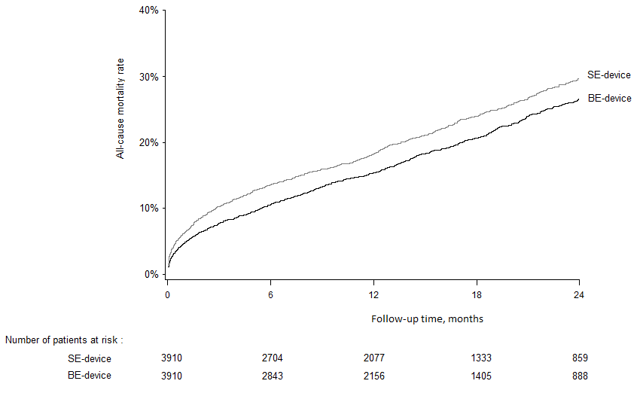
2nd co-Primary outcome : 2 year all-cause mortality in PS-matched cohort
P=0.002

Slide 24
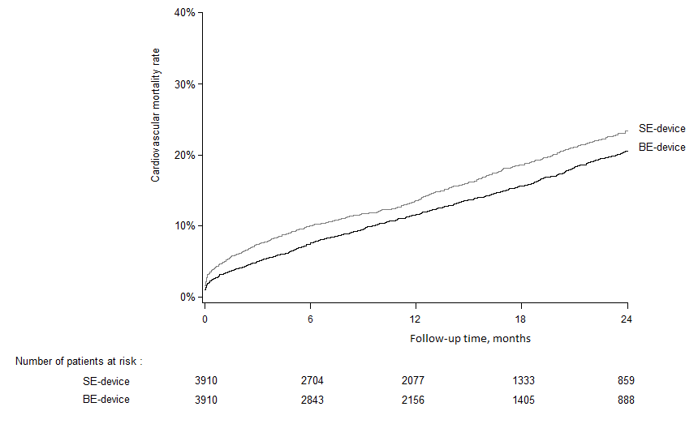
2nd co-Primary outcome : 2 year cardiovascular mortality in PS-matched cohort
P=0.001

Slide 25
2nd co-Primary outcome : Effect of time on all-cause mortality
Propensity-score matched cohort
Outcomes | SE-THV (n=3910) | BE-THV (n=3910) | Effect size (95%CI) | P-value
Follow-up all-cause mortality | 899 (29.8) | 801 (26.6) | 1.17 (1.06 to 1.28)* | 0.002
0 to 3 months | 381 | 286 | 1.37 (1.16 to 1.60)* | 0.0001
3 to 6 months | 104 | 92 | 1.23 (0.88 to 1.70)* | 0.22
6 month to end of follow-up | 414 | 423 | 1.00 (0.85 to 1.18)* | 0.89
Values in brackets in columns 2 and 3 are cumulative incidence at 2-year expresses as % (calculated using Kalbfleisch and Prentice for follow-up hospitalizations by treating death as competing risk, or using Kaplan-Meier method for mortality) * calculated using a Fine and Gray or Cox’s regression model stratified by center with the robust sandwich variance estimate to account the matched sets.

Slide 26
2nd co-Primary outcome : Effect of time on all-cause mortality
Propensity-score matched cohort
Outcomes | SE-THV (n=3910) | BE-THV (n=3910) | Effect size (95%CI) | P-value
Follow-up all-cause mortality | 899 (29.8) | 801 (26.6) | 1.17 (1.06 to 1.28)* | 0.002
0 to 3 months | 381 | 286 | 1.37 (1.16 to 1.60)* | 0.0001
3 to 6 months | 104 | 92 | 1.23 (0.88 to 1.70)* | 0.22
6 month to end of follow-up | 414 | 423 | 1.00 (0.85 to 1.18)* | 0.89
Values in brackets in columns 2 and 3 are cumulative incidence at 2-year expresses as % (calculated using Kalbfleisch and Prentice for follow-up hospitalizations by treating death as competing risk, or using Kaplan-Meier method for mortality) * calculated using a Fine and Gray or Cox’s regression model stratified by center with the robust sandwich variance estimate to account the matched sets.

Slide 27
2nd co-Primary outcome : Effect of time on all-cause mortality
Propensity-score matched cohort
Outcomes | SE-THV (n=3910) | BE-THV (n=3910) | Effect size (95%CI) | P-value
Follow-up all-cause mortality | 899 (29.8) | 801 (26.6) | 1.17 (1.06 to 1.28)* | 0.002
0 to 3 months | 381 | 286 | 1.37 (1.16 to 1.60)* | 0.0001
3 to 6 months | 104 | 92 | 1.23 (0.88 to 1.70)* | 0.22
6 month to end of follow-up | 414 | 423 | 1.00 (0.85 to 1.18)* | 0.89
Values in brackets in columns 2 and 3 are cumulative incidence at 2-year expresses as % (calculated using Kalbfleisch and Prentice for follow-up hospitalizations by treating death as competing risk, or using Kaplan-Meier method for mortality) * calculated using a Fine and Gray or Cox’s regression model stratified by center with the robust sandwich variance estimate to account the matched sets.

Slide 28
2nd co-Primary outcome : Effect of time on all-cause mortality
Propensity-score matched cohort
Outcomes | SE-THV (n=3910) | BE-THV (n=3910) | Effect size (95%CI) | P-value
Follow-up all-cause mortality | 899 (29.8) | 801 (26.6) | 1.17 (1.06 to 1.28)* | 0.002
0 to 3 months | 381 | 286 | 1.37 (1.16 to 1.60)* | 0.0001
3 to 6 months | 104 | 92 | 1.23 (0.88 to 1.70)* | 0.22
6 month to end of follow-up | 414 | 423 | 1.00 (0.85 to 1.18)* | 0.89
Values in brackets in columns 2 and 3 are cumulative incidence at 2-year expresses as % (calculated using Kalbfleisch and Prentice for follow-up hospitalizations by treating death as competing risk, or using Kaplan-Meier method for mortality) * calculated using a Fine and Gray or Cox’s regression model stratified by center with the robust sandwich variance estimate to account the matched sets.

Slide 29
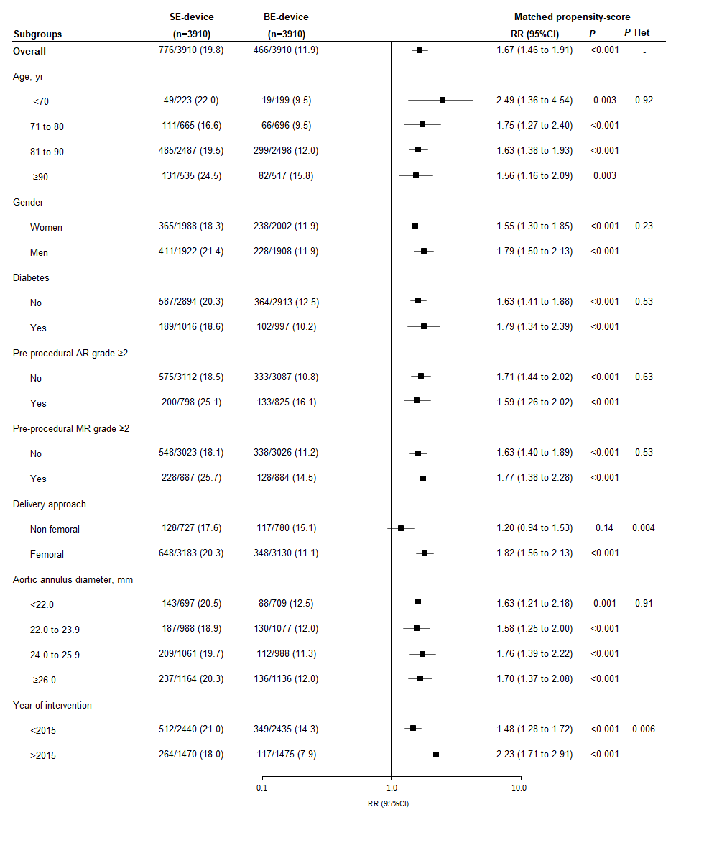
Subgroup analysis
1st co-primary outcome according to key subgroups
The relation between the occurrence of outcome and THV-design was consistent across key subgroups, except for delivery approach and year of intervention:
The difference was stronger in femoral TAVR (RR=1.82; 95%CI:1.56-2.13) than in non-femoral TAVR (RR=1.20; 95%CI:0.94-1.53, p for heterogeneity=0.004)
The difference was also stronger in the second (≥01 January 2015, RR=2.23; 95%CI:1.71-2·94) as compared to the first-study period (<01 January 2015, RR=1.48; 95%CI:1.28-1.72; p for heterogeneity=0.006)
Notes:
Supprimer?

Slide 30
1st co-Primary outcome: sensitivity analysis of patients treated after 01/2015
P<0.001
P<0.001
P=0.11
*pre-specified as 1st co-primary outcome measure

Slide 31
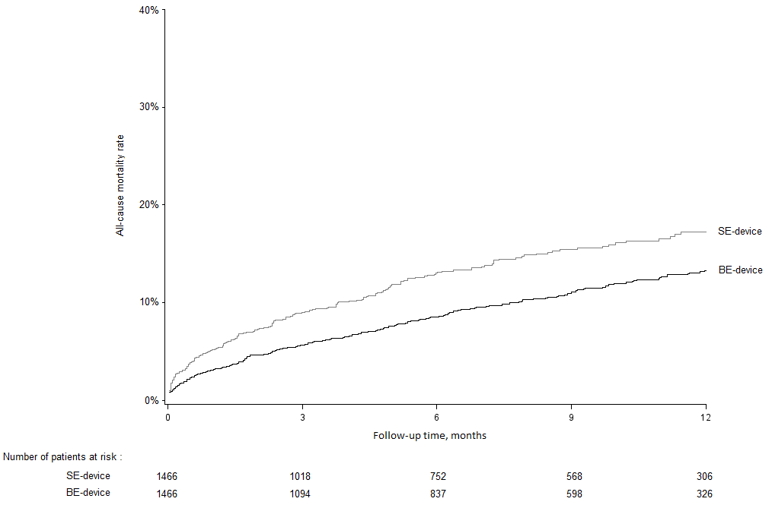
2nd co-Primary outcome: all-cause mortality (sensitivity analysis of patients treated after 01/2015)
P=0.005
*pre-specified as 1st co-primary outcome measure

Slide 32
Impact of PVR on all-cause mortality
 | PVR ≥ moderate |  | Unadjusted HR
 | No | Yes | (95%CI) | P | P het
 | All-cause mortality (%)
Overall | 17.4 | 26.1 | 1·41 (1·23-1·60) | <0·001
THV design
SE-THV | 21.0 | 27.5 | 1·38 (1·15-1·65) | <0·001 | 0·88
BE-THV | 15.7 | 24.5 | 1·34 (1·11-1·62) | 0·002

Slide 33
Impact of PVR on all-cause mortality
 | PVR ≥ moderate |  | Unadjusted HR
 | No | Yes | (95%CI) | P | P het
 | All-cause mortality (%)
Overall | 17.4 | 26.1 | 1·41 (1·23-1·60) | <0·001
THV design
SE-THV | 21.0 | 27.5 | 1·38 (1·15-1·65) | <0·001 | 0·88
BE-THV | 15.7 | 24.5 | 1·34 (1·11-1·62) | 0·002

Slide 34
Multivariable analysis – Predictors of all-cause mortality
 | HR (95% CI) | P-value
Paravalvular Regurgitation
None | 1.00 (reference) | -
Mild | 1.13 (1.01-1.27) | 0.032
Moderate | 1.42 (1.19-1·68) | <0·001
Severe | 1.86 (1.19-2.90) | 0·006
THV design (BE-THV as reference)
0-3 months | 1.42 (1.17-1·63) | <0.001
3-6 months | 1.20 (0.98-1.61) | 0.23
6 month-end of follow-up | 0.94 (0.77-1.06) | 0.41
HRs were calculated using Backward-stepwise multivariable Cox’s regression after handling missing values by multiple imputation procedure (m=10); candidate factors were factors associated with mortality imodels n univariable Cox’s regression models (at p<0·10):Age ≥90-years, Men, NYHA, Euroscore, High operative risk, BMI, Diabetes, hypertension, CAD, previous stroke/TIA, PAD, Atrial fibrillation, permanent pacemaker, respiratory insuffisiency, annulus diameter, LVEF, AVA, Transaortic gradient, MR grade≥2, femoral approach, PVR, second THV, Stroke, myocardial infarction, major/life threatening bleeding, permanent pacemaker implantation

Slide 35
Limitations
This is a comparison between THV designs from an observational registry and not a randomized controlled trial
Potential unmeasured residual confounders might remain despite the PS matching analysis
PVR grading and clinical events (except mortality) were site-reported
Some of the most recent THV iterations were not part of the investigation

Slide 36
Conclusion
Largest study to date (n=12,141) allowing a propensity­-score comparison of outcomes between SE-­THV and BE-THV when used to treat patients with native aortic stenosis.
The use of SE-THV was associated with a higher risk of PVR at discharge, a higher risk of in-hospital mortality, and a higher risk of 2 year mortality, as compared with BE­-THV.
The higher risk of mortality persisted after multivariable adjustment including PVR severity and other peri-procedural events.
These results suggest that the two most widely used THV designs may not achieve the same clinical outcomes.
Overall, the present study strongly supports to conduct a randomized trial powered to compare head-­to-­head the most recent iterations of SE- and BE-THV on all-cause mortality.

Slide 37
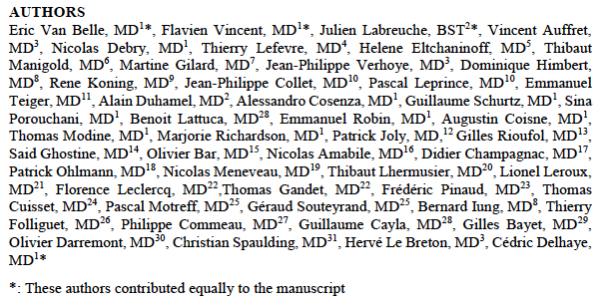
Simultaneous on-line publication
ScientificSessions.org
#AHA19

Slide 38
Acknowlegments
We thank for their precious help and support the French Society of Cardiology and its President Martine Gilard and the GACI (Groupe Atherome et Cardiologie Interventionelle) and its President Philippe Commeau
To Vincent Bataille for his precious help in data management
To all our clinical research team : Anaïs Gaul, Ludivine Masquelin, Géneviève Pin, Tom Denimal, Thibault Pamart, Basile Verdier, Hugues Spillemaeker
ScientificSessions.org
#AHA19

